Slide 1
Introduction to SQL
Lesson 9.1

Slide 2
Learning Outcomes
By the end of this unit, you will be able to:
01
02
03
Create a data model to represent the objects and relationships in a dataset.
Create schemas, tables, and databases for relational data.
Retrieve data using advanced database queries.

Slide 3
Class Objectives
By the end of today’s class, you will:
Install PostgreSQL and pgAdmin on your computer.
Create databases and tables using pgAdmin.
Define SQL data types, primary keys, and unique values.
Load CSV files into a database.
Query data from a database.
Articulate the four basic functions of CRUD and apply them to a database.
Combine data from multiple tables using JOINs.

Slide 4
Why SQL?
Structured Query Language (SQL) is one of the main query languages used to access data within relational databases.
SQL is designed to efficiently handle large amounts of data, which is a highly valued capability for organizations.
Experienced SQL programmers are in high demand.
Programming, Scripting, and Markup Languages (all respondents)
JavaScript
HTML
CSS
SQL
Java
Bash/Shell
Python
C#
PHP
C++
C
TypeScript
Ruby
Swift
69.8%
68.5%
65.1%
57.0%
45.3%
39.8%
38.8%
34.4%
30.7%
25.4%
23.0%
17.4%
10.1%
8.1%
Data provided by 2018 Stack Overflow Survey
Notes:
Data provided by 2018 Stack Overflow Survey

Slide 5
Postgres and pgAdmin

Slide 6

Postgres
PostgreSQL (typically referred to as "Postgres") is an object-relational database system that uses the SQL language.
Database engine
Open source
Great functionality

Slide 7
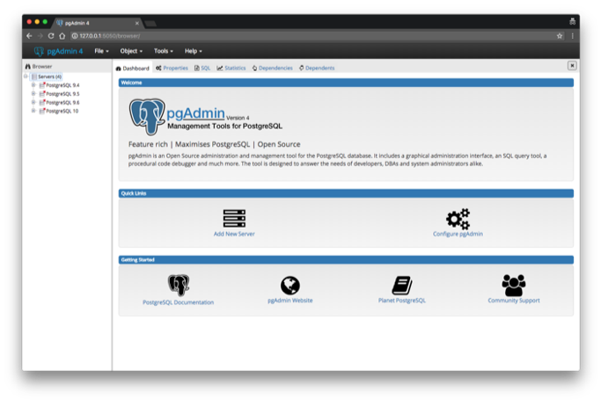
pgAdmin
pgAdmin is the management tool used for working with Postgres. It simplifies the creation, maintenance, and use of database objects.

Slide 9

Take a Break!

Slide 10
CRUD

Slide 11
CRUD Operations
Create Read Update Delete is a set of operations used with persistent storage.
Create | INSERT INFO table (column1, column2, column3)
Read | SELECT * FROM table
Update | UPDATE table SET column1 = VALUE WHERE id = 1
Delete | DELETE FROM table WHERE id = 5
These tools are fundamental to all programming languages—not just SQL.

Slide 12
Wildcards

Slide 13
Wildcards: % and _
Wildcards are used to substitute zero, one, or multiple characters in a string. The keyword LIKE indicates the use of a wildcard.
SELECT *
FROM actor
WHERE last_name LIKE ‘Will%’;
SELECT *
FROM actor
WHERE first_name LIKE ‘_AN’;
The % will substitute zero, one, or multiple characters in a query.
For example, all of the following will match: Will, Willa, and Willows.
The _ will substitute one, and only one, character in a query.
_AN returns all actors whose first name contains three letters, the second and third of which are AN.

